Slide 1

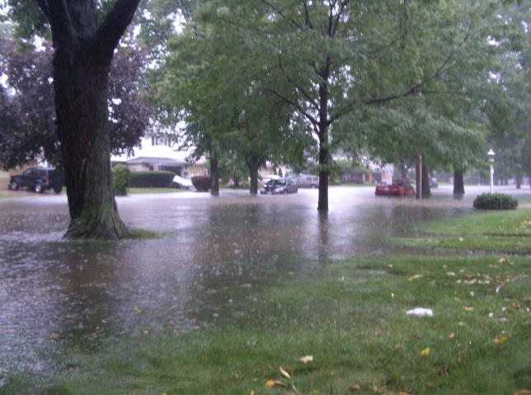
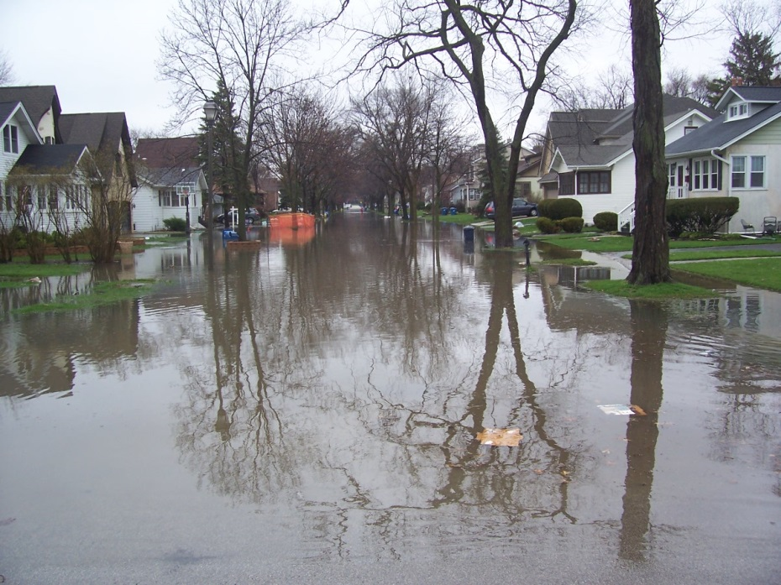
August 14, 2013
City of Elmhurst
Comprehensive Flood Plan
Presentation to Elmhurst Park District
Prepared by
CBBEL

Slide 2
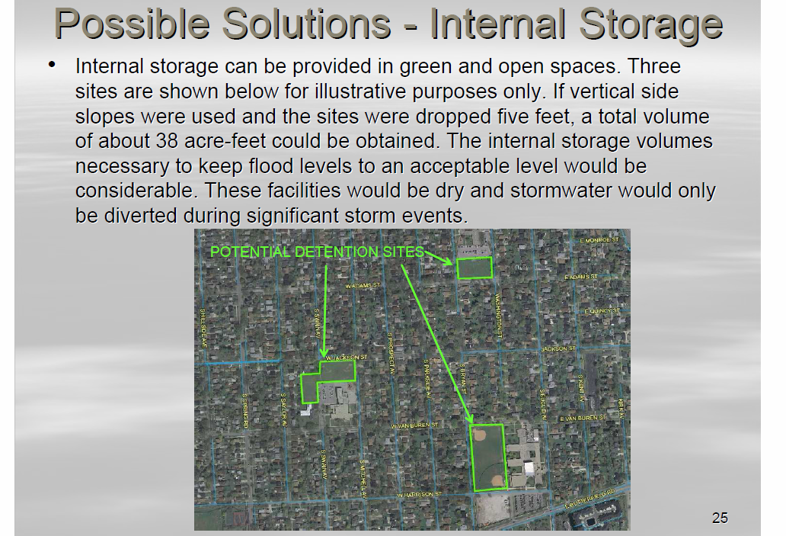
Creation of Flood Storage
Prior to developing the comprehensive flood plan, CBBEL identified open parcels to create flood storage. The slide below is from the Storm Sewer Presentation given in November 2010.
2

Slide 3
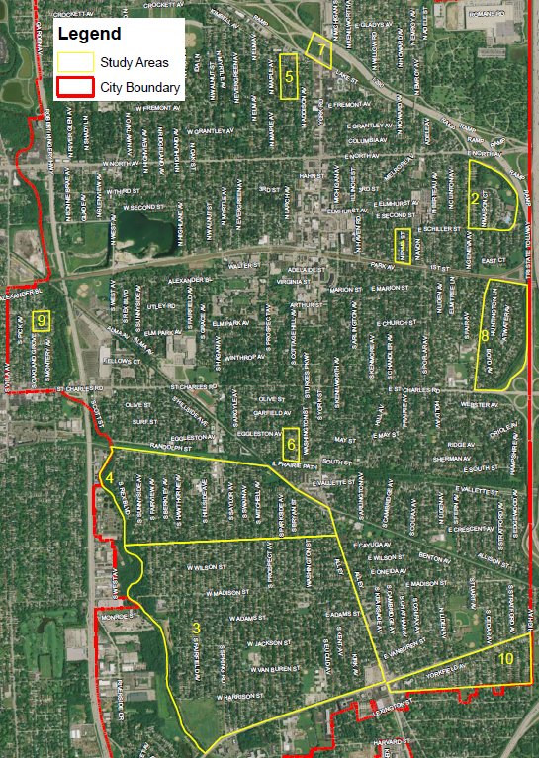
Study Background
CBBEL hired by City to develop comprehensive flood plan following June and July 2010 storm events.
Developed hydrologic and hydraulic modeling to determine flooding solutions for ten storm sewer study areas.
East End Park
Golden Meadows Park
Wild Meadows Trace
Pioneer Park
York Commons Park
PARK SITES
3

Slide 4
Flood Storage Volume
One acre-foot is the equivalent of an acre of land that is one foot deep.
The volume is approximately equivalent to:
  A flat football field with a depth of 1 foot
  The Multi-Purpose Room in the Abbey with a depth of 12 feet
  2,520 feet of roadway with pervious pavement (24’ W * 2’ D * 2,520’ L)
  55,462 linear feet of 12-inch diameter pipe
As shown in the following slides, the
volume of stormwater in the streets,
yards, and homes during the July 2010
storm event was significant. An even
greater amount was seen during the
April 18, 2013 storm event.
4

Slide 5
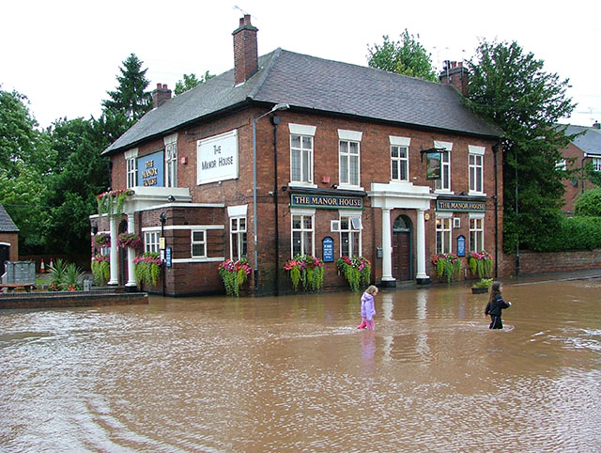
Stormwater Runoff Volume
Runoff volume for a typical
residential lot in Elmhurst
  0.20-acre lot (8,712 ft²)
  40% impervious coverage
Storm Event | Stormwater Runoff Volume
 | Gallons | Rain Barrels* | Acre-Feet
July 2010 | 28,349 | 515 | 0.087
April 2013 | 30,304 | 551 | 0.093
*Rain Barrel is 55 gallons
5

Slide 6
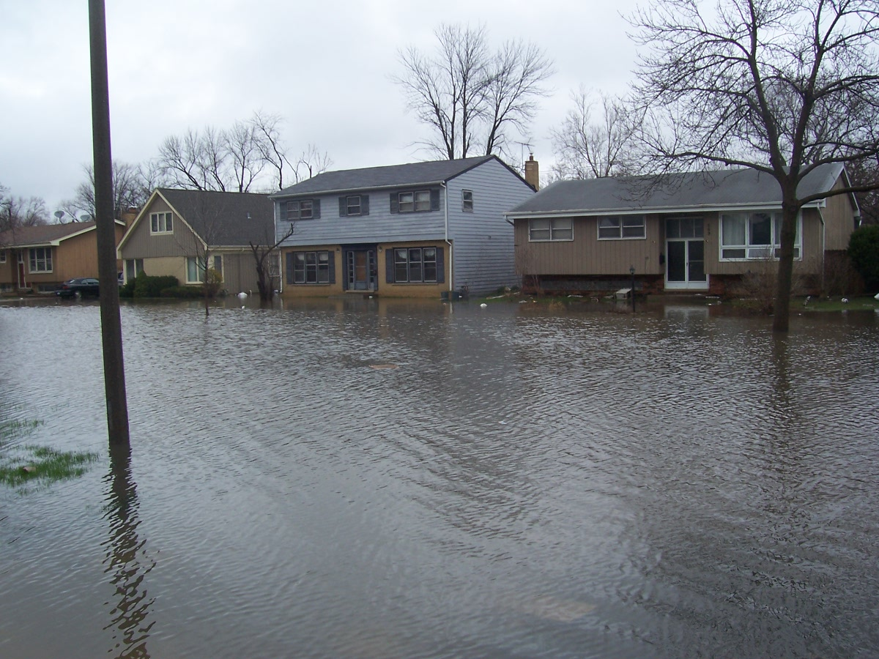
April 18, 2013 Storm Event
Southwest Elmhurst
6

Slide 7

April 18, 2013 Storm Event
Southwest Elmhurst
7

Slide 8
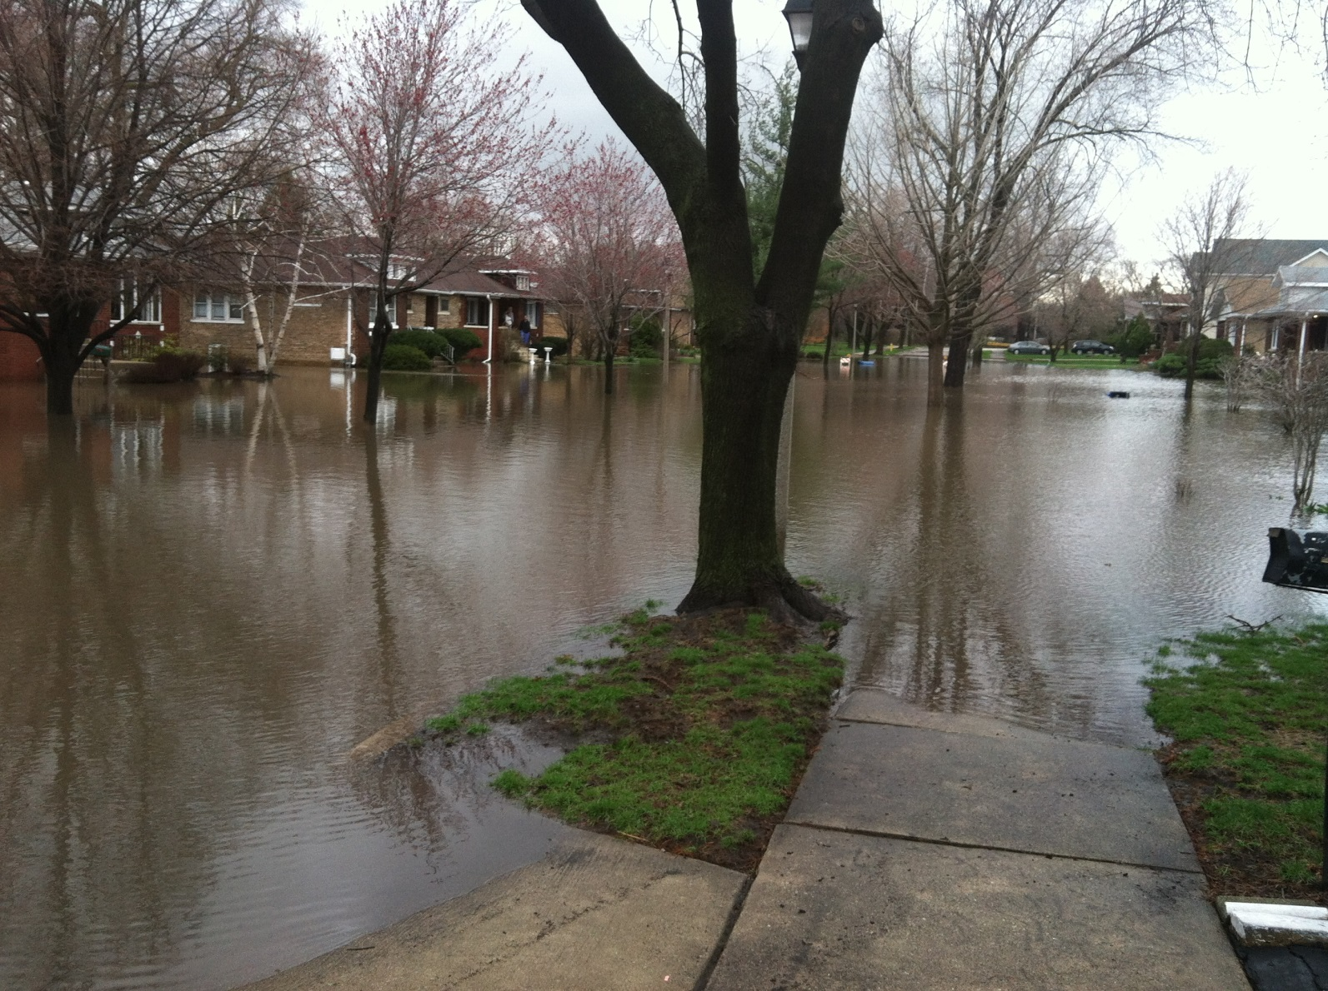
April 18, 2013 Storm Event
Geneva Avenue
8

Slide 9
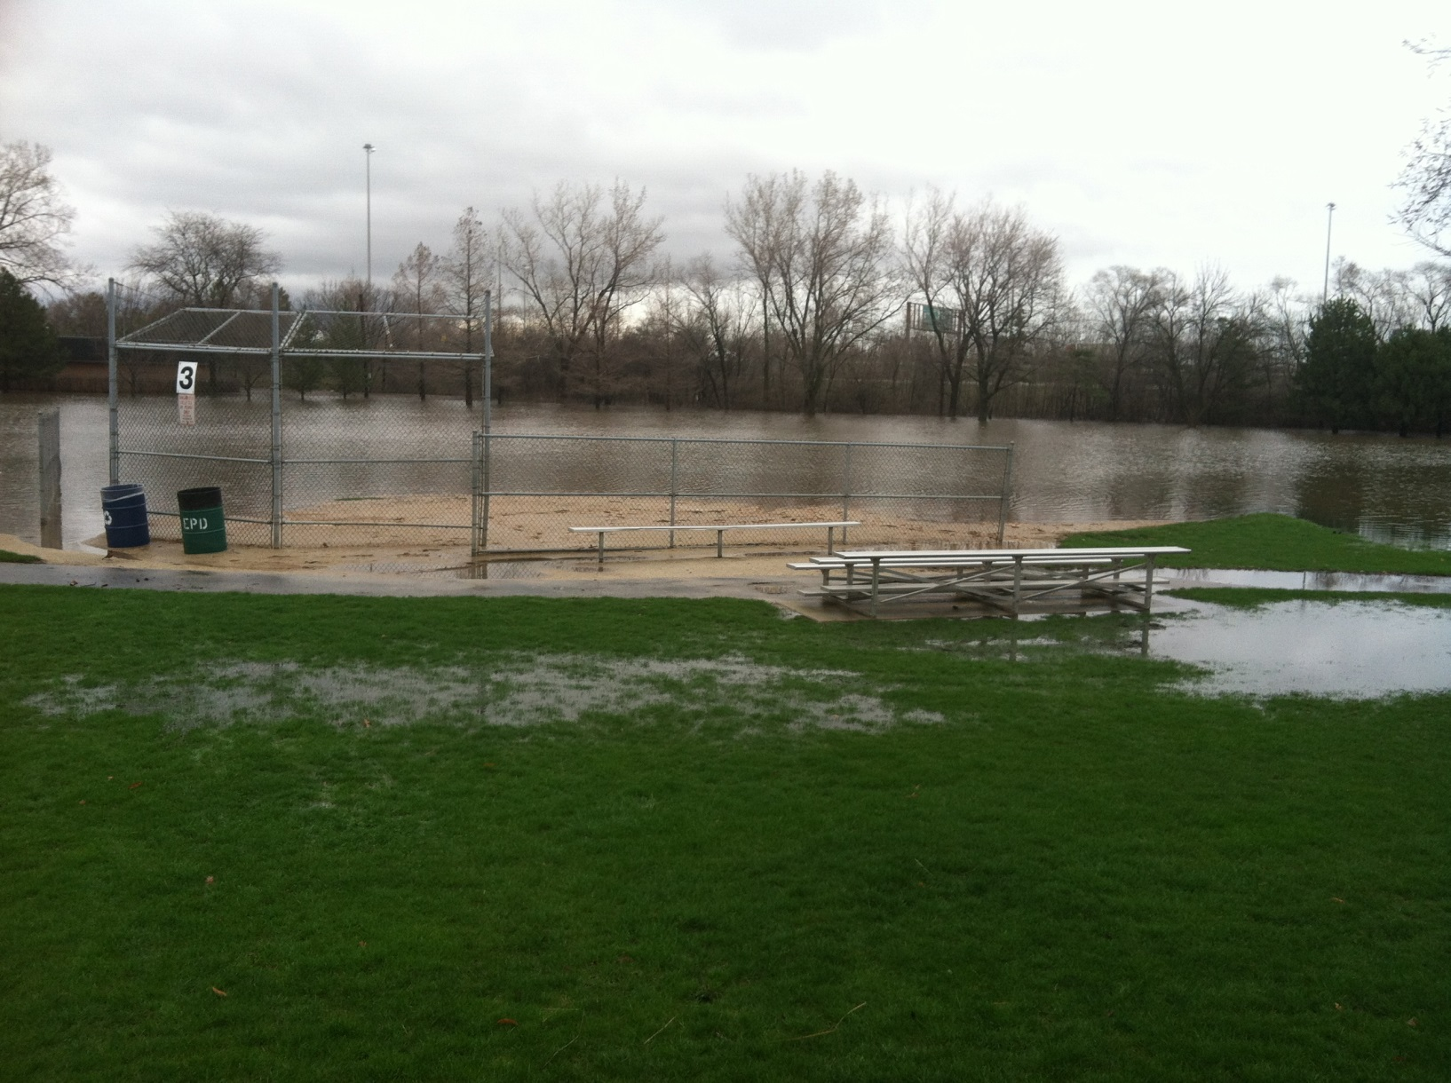
April 18, 2013 Storm Event
East End Park
9

Slide 10
Stormwater Detention Requirements
Since the majority of the City of Elmhurst was developed prior to the adoption of the County-wide stormwater regulations, there are few stormwater management facilities (detention) in the flood problem areas. If these areas were developed under today’s standards, the volume of stormwater detention required would be up to 10 times more volume than what would be provided under the proposed flood storage improvements.
Flood Study Area | Tributary Area (acres) | Approximate Stormwater Detention Volume Required (acre-feet)*
Southwest Elmhurst | 1,013 | 383
Pine Street | 88 | 34
Geneva Avenue | 109 | 42
Brynhaven Subdivision | 447 | 170
Seminole & Cottage Hill | 179 | 68
TOTAL | 1,836 | 697
*Based on DuPage County stormwater detention nomograph
10

Slide 11
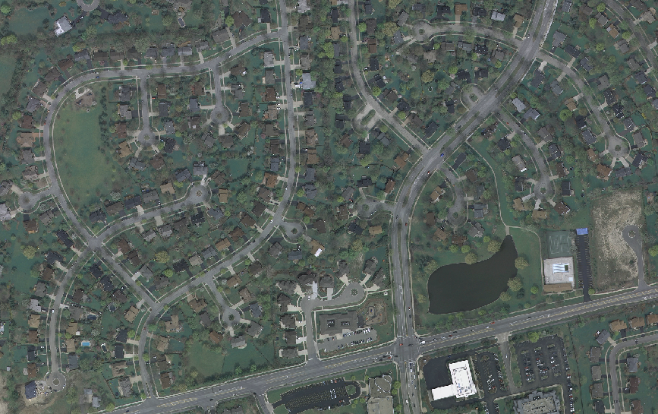
Stormwater Detention Requirements
For communities developed after 1992 (adoption of the DuPage County Stormwater Ordinance), such as Naperville, stormwater detention was constructed as part of the development.
STORMWATER DETENTION BASIN
11

Slide 12
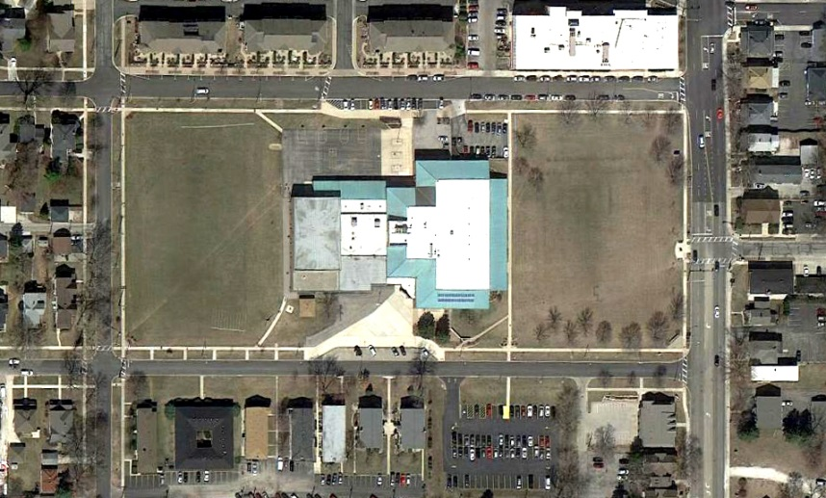
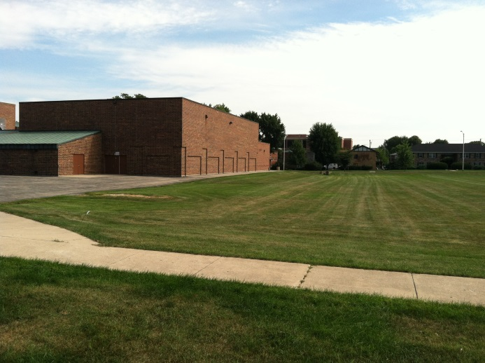
School / Stormwater Example
Washington Junior High - Naperville
DRY
BOTTOM DETENTION
AREA
Flood Storage
Washington Junior High
16 out of the 22 District 203 school sites have dry-bottom detention facilities that are also utilized for Physical Education. This facility at Washington Junior High is also used for football practice.
12

Slide 13
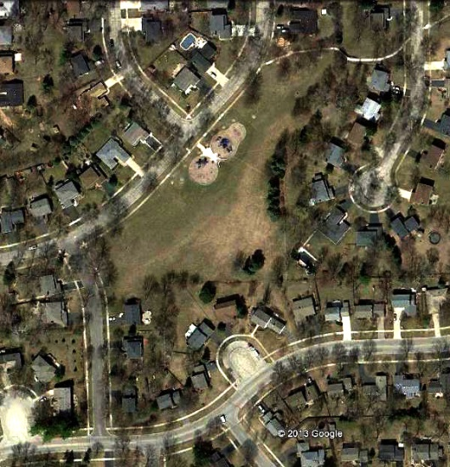
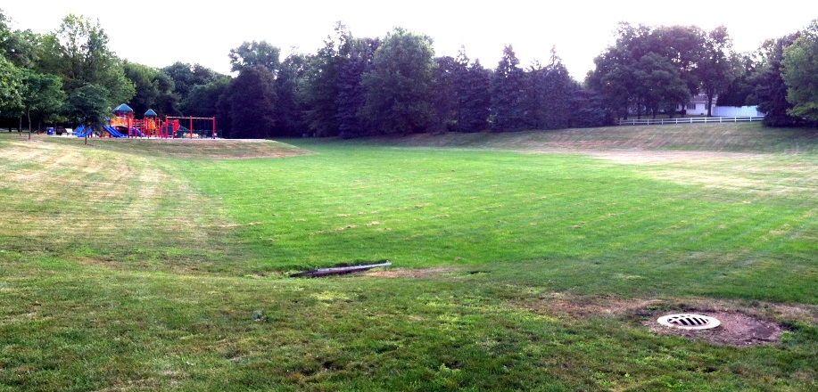
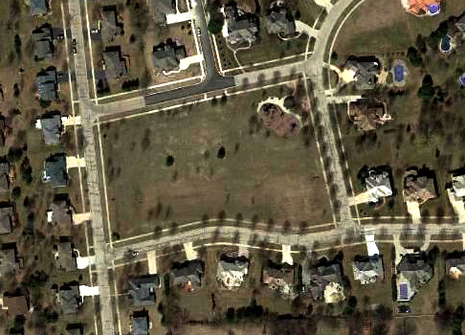
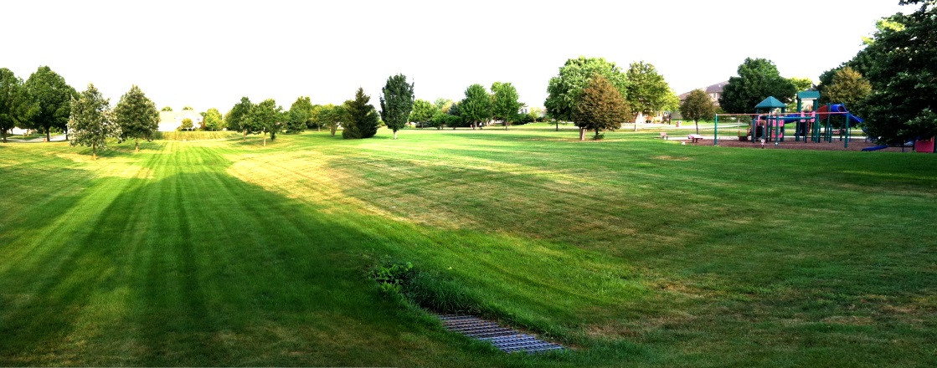
Park / Stormwater Example
Naperville Park District
30 out of the 141 District park sites are dual-purpose dry-bottom facilities
Eagle Park
Three Meadows Park
13

Slide 14
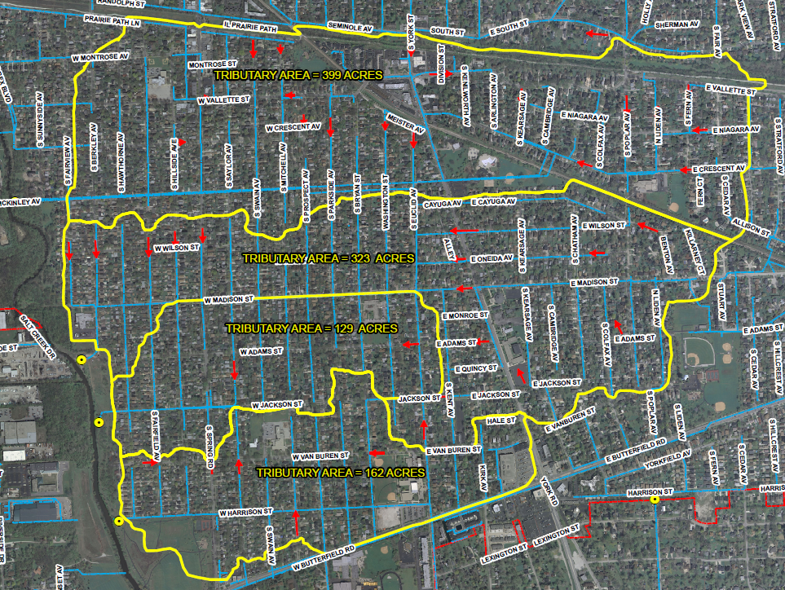
Existing Drainage Patterns – SW Elmhurst
14

Slide 15
Proposed Drainage Patterns – SW Elmhurst
Divert Stormwater Into York Commons Park
15

Slide 16
Summary of Elmhurst Study Areas
Problem Area Location | Number of Homes Flooded in 100-Year Storm Event | Potential Flood Storage Location
Southwest Elmhurst (Washington Street, Crescent Avenue, and Vallette & Swain Flood Problem Areas) | 195 | York Commons Park
Pine Street | 20 | Golden Meadows Park
Geneva Avenue | 8 | East End Park
Brynhaven Subdivision | 2 | Golden Meadows Park
Seminole & Cottage Hill | 4 | Pioneer Park Wild Meadows Trace
TOTAL | 229
16

Slide 17
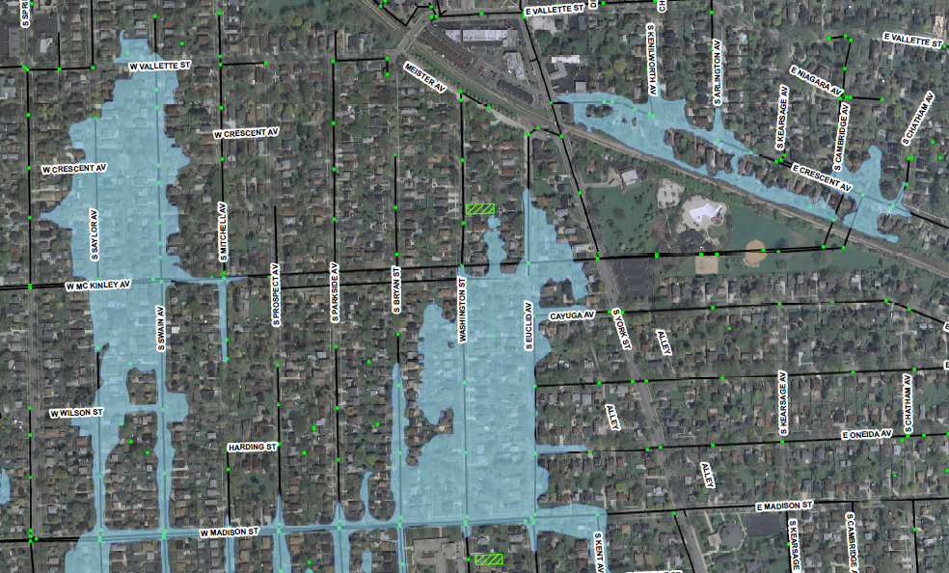
Southwest Study Area (North Side)
XP-SWMM Simulated July 2010 Inundation Area
Would benefit from York Commons Park flood storage
VOLUME = 8 AC-FT
E
C
VOLUME = 10 AC-FT
YORK COMMONS
PARK
D
VOLUME = 12 AC-FT
17

Slide 18
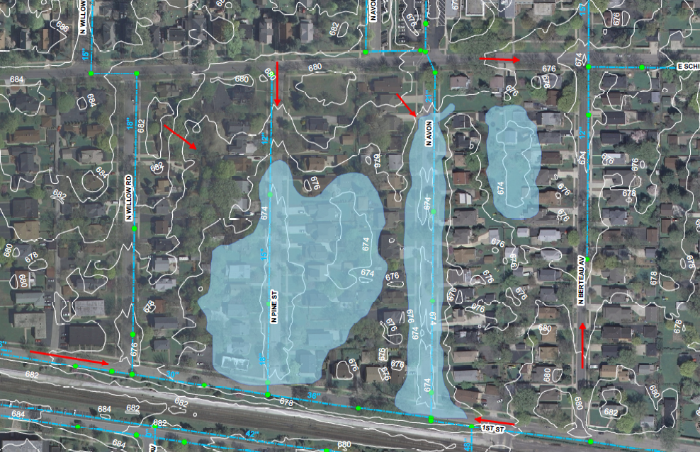
Pine Street Study Area
XP-SWMM Simulated July 2010 Inundation Area
Would benefit from Golden Meadows Park flood storage
VOLUME = 11 AC-FT
18

Slide 19
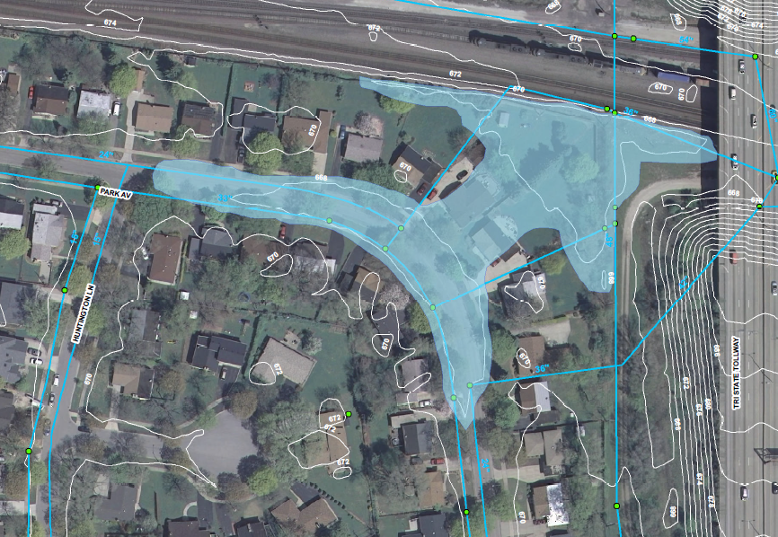
Brynhaven Subdivision
XP-SWMM Simulated July 2010 Inundation Area
Would benefit from Golden Meadows Park flood storage
VOLUME = 2 AC-FT
19

Slide 20
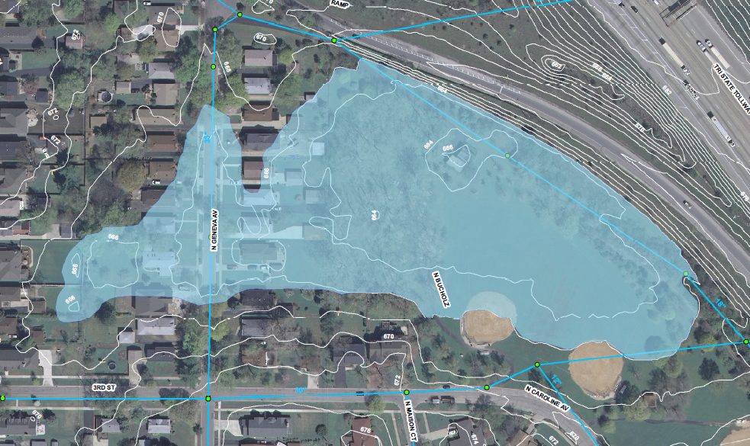
Geneva Avenue Study Area
XP-SWMM Simulated July 2010 Inundation Area
Would benefit from East End Park flood storage
VOLUME = 12 AC-FT
EAST END
PARK
20

Slide 21
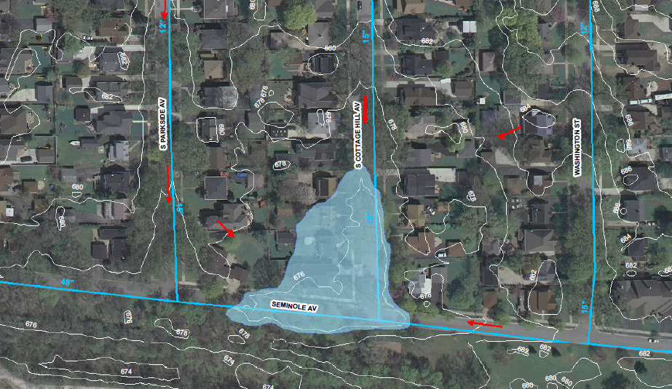
Seminole Avenue Study Area
XP-SWMM Simulated July 2010 Inundation Area
Would benefit from Pioneer Park or Wild Meadows Trace flood storage
VOLUME = 2 AC-FT
VOLUME = 3 AC-FT
21

Slide 22
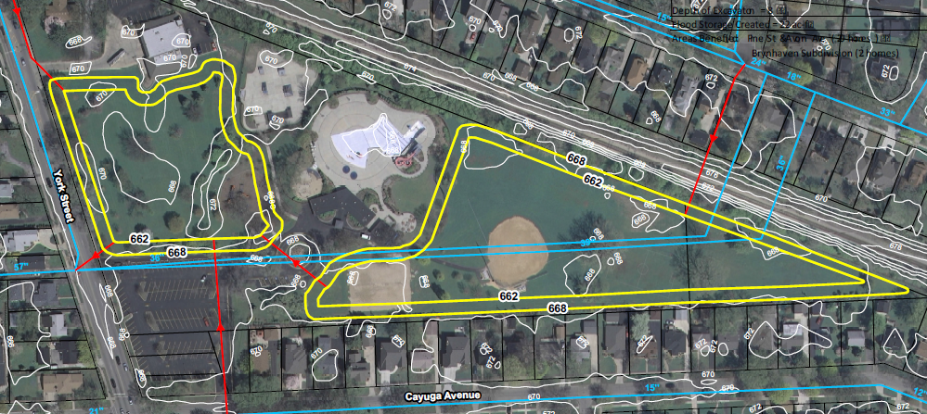
Creation of Flood Storage Volume
The objective is to create storage to reduce the level of flooding.
For less frequent storm events, pipes would divert stormwater away from the flood-prone areas and convey it to the dual-purpose sites.
The stormwater will be held temporarily at the site and then drain by gravity to the existing storm sewer system following a storm.
22

Slide 23
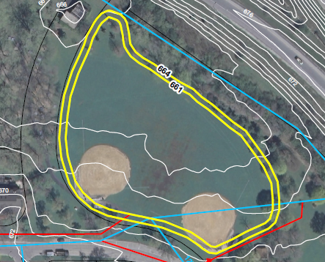
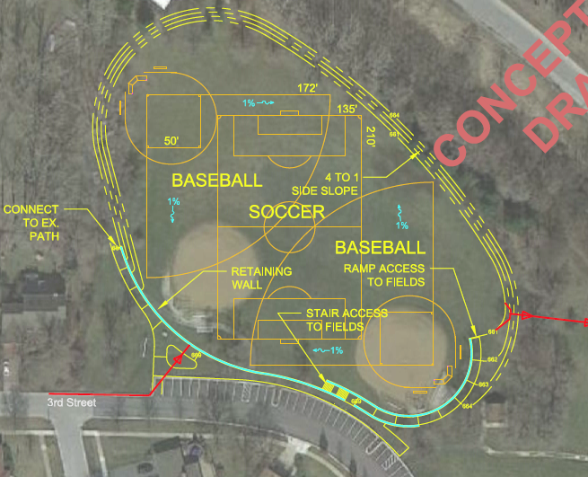
Conceptual Facility Improvement Plans
Since the flood study was completed, CBBEL developed facility improvement plans to illustrate what the sites might look like under proposed conditions.
23

Slide 24
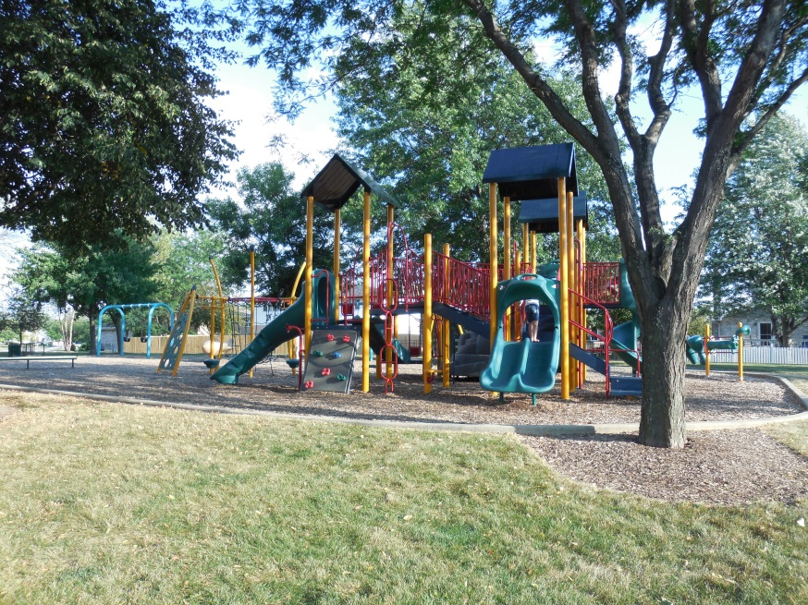
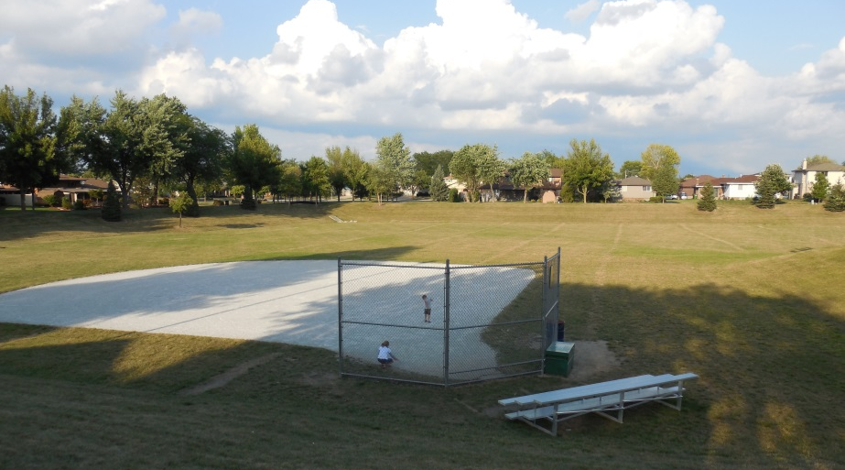
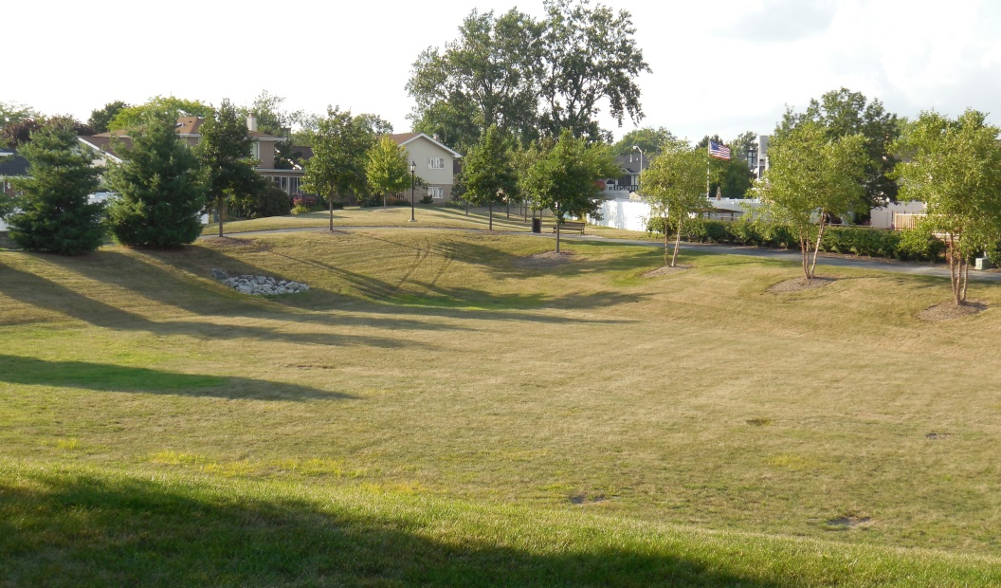
Dual-Purpose Facility Example
Pottawattomie Park – Tinley Park (2003)
Softball Diamond
Playground
Flood Storage
24

Slide 25
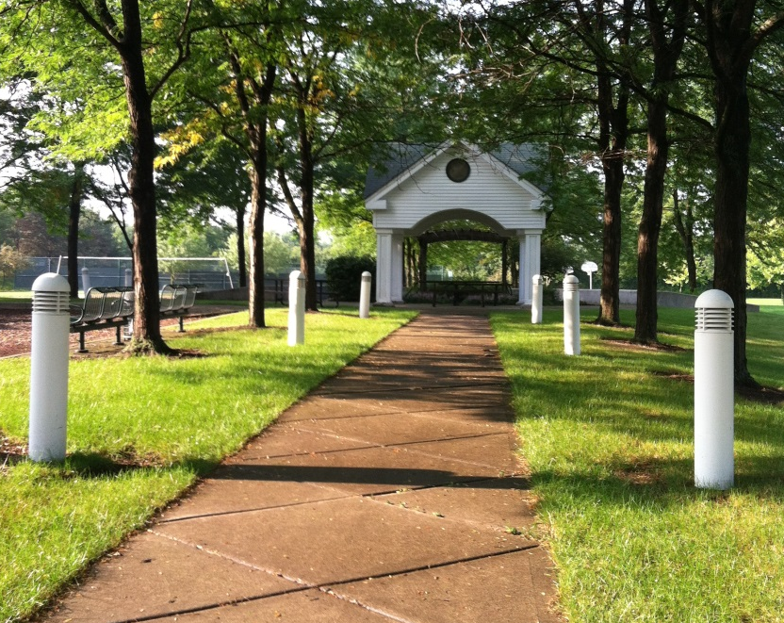
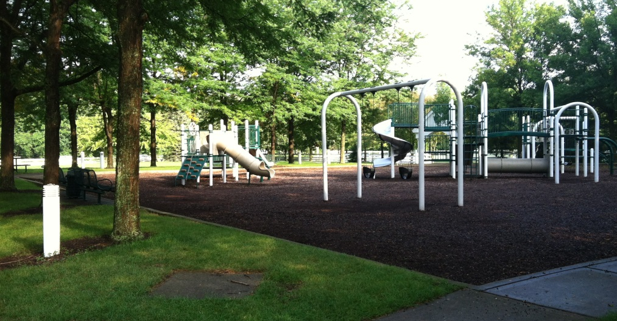
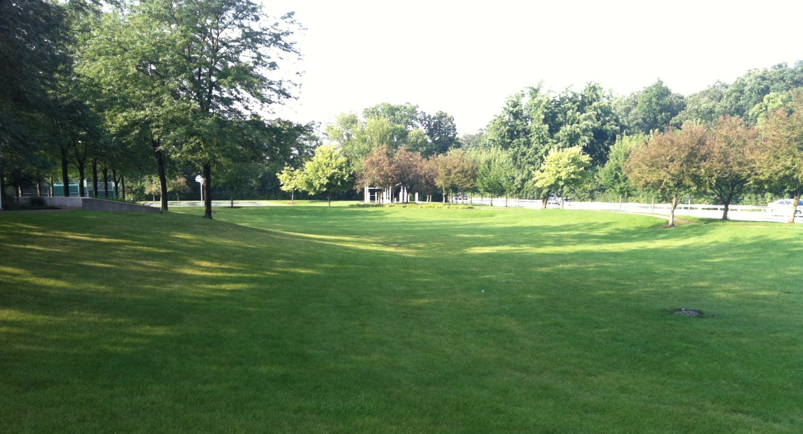
Dual-Purpose Facility Example
Whytegate Park – Lincolnshire (1990)
Playground
Gazebo
Flood Storage
25

Slide 26
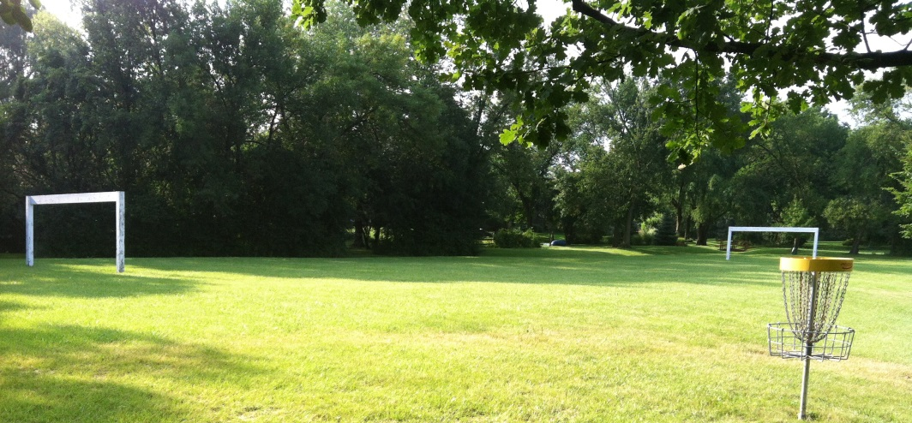
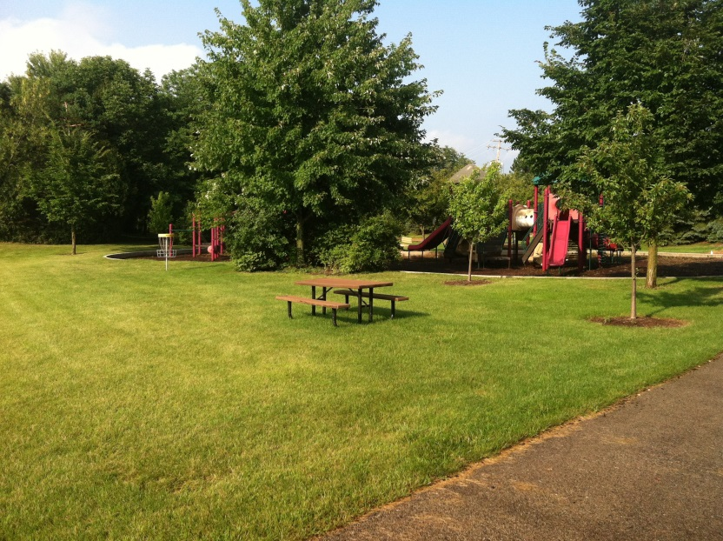
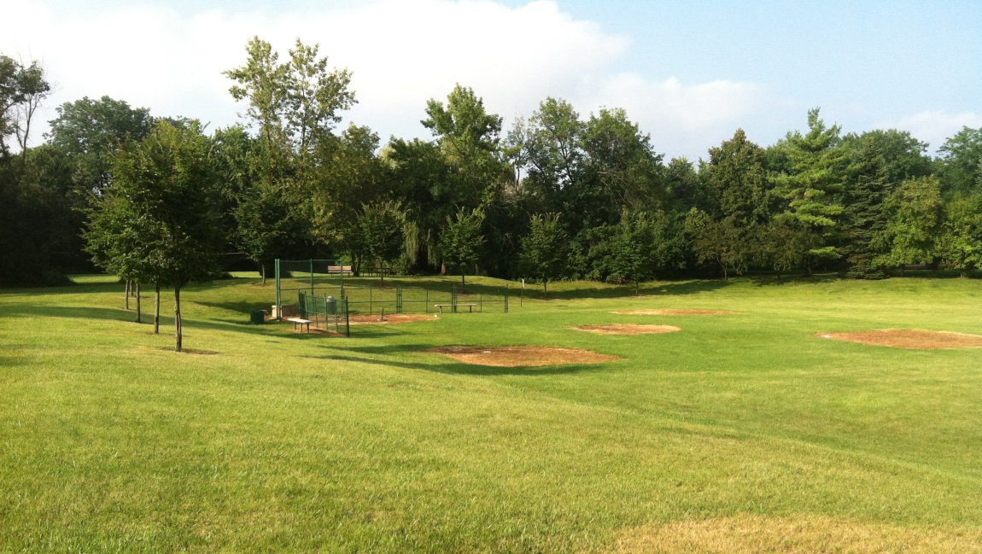
Dual-Purpose Facility Example
Old Mill Park – Lincolnshire (1992)
Soccer Field
Playground
Baseball Diamond/Flood Storage
26

Slide 27
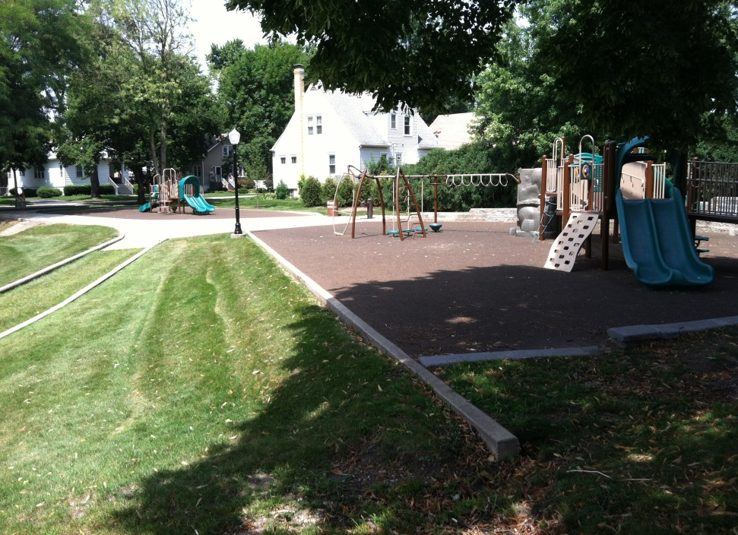
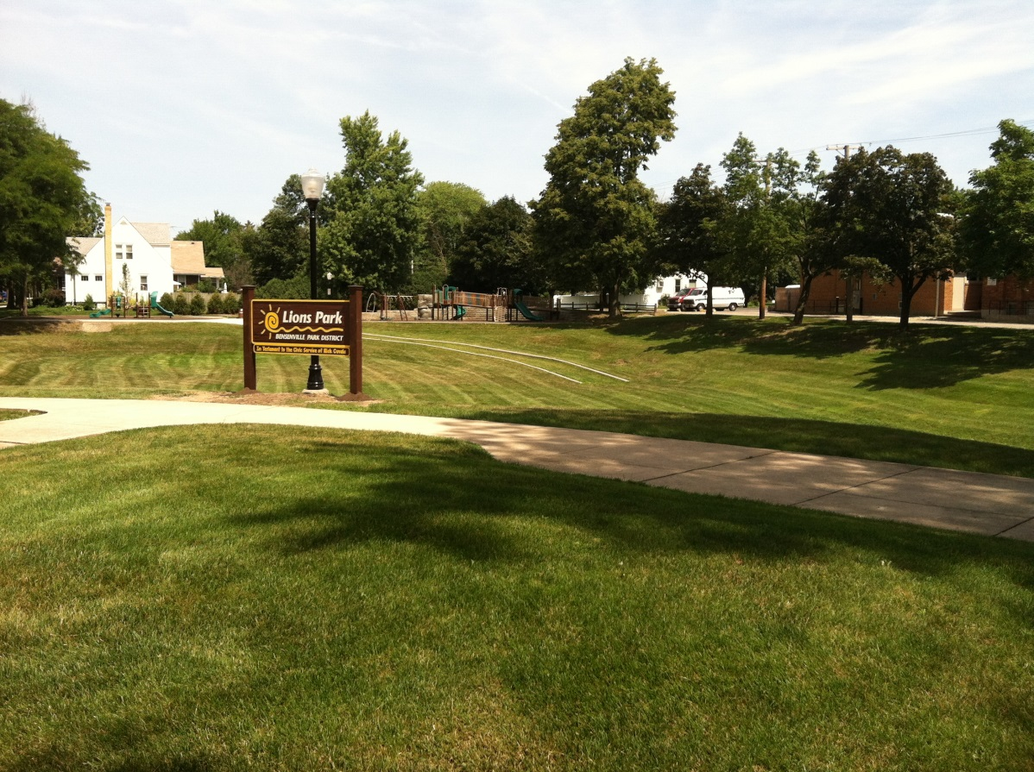
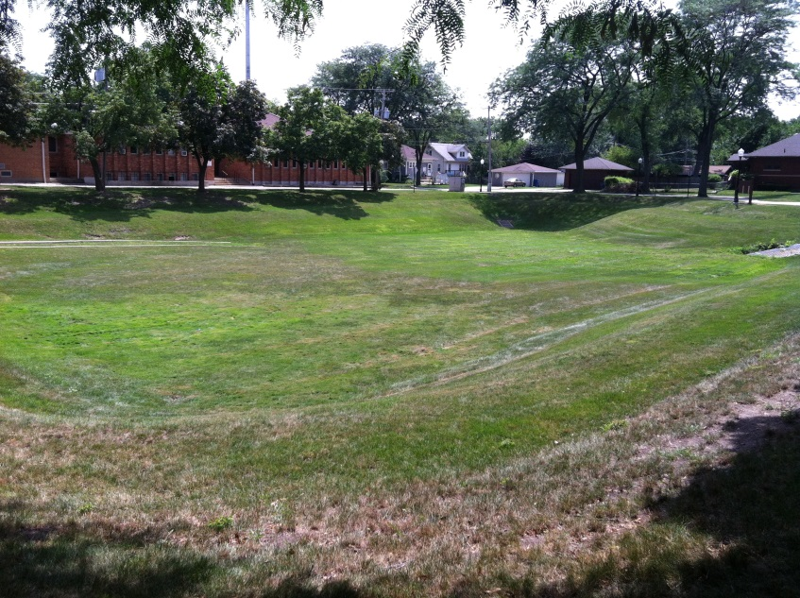
Dual-Purpose Facility Example
Lions Park – Bensenville (1993)
Softball Diamond
Playground
Flood Storage
27

Slide 28
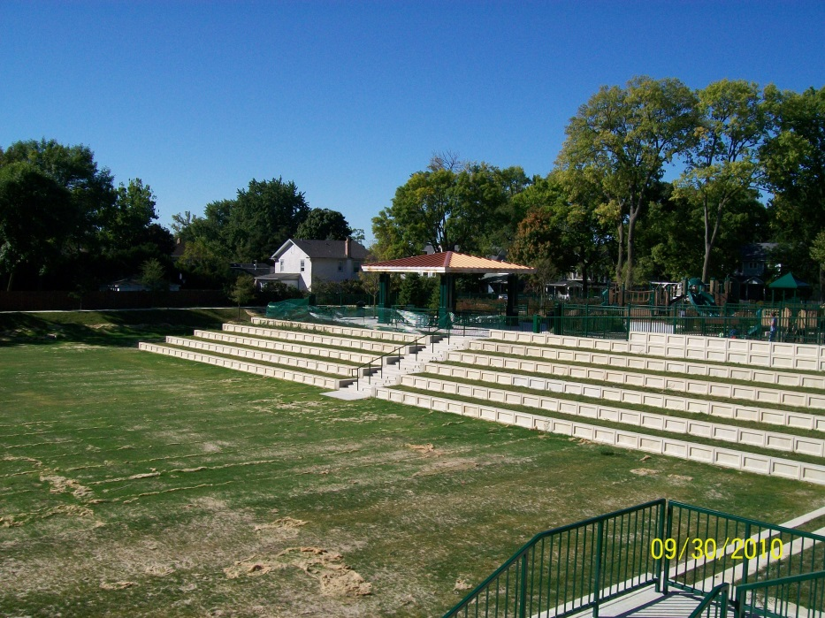
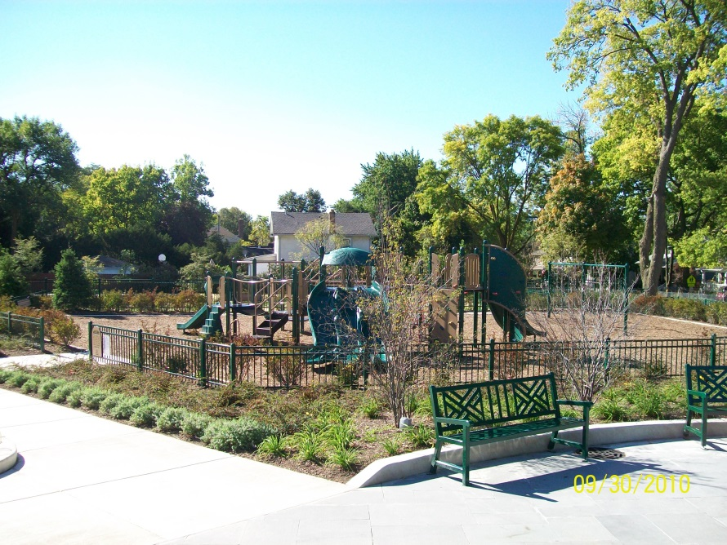
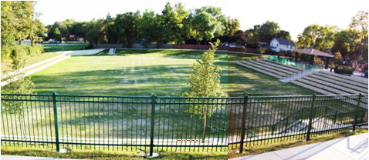
Dual-Purpose Facility Example
Washington Park – Downers Grove (2010)
Playground
Playing Field with Seating
Flood Storage
28

